Slide 1
Albeni Falls Dam Operations
Ryne Linehan, Operations Project Manager Albeni Falls Dam
Joel Fenolio, Upper Columbia Senior Water Manager
Seattle District
August 27th, 2014

Slide 2
Agenda
Introductions
Albeni Falls Dam Background
Review Operations this Spring 2014
Operations this Fall and Winter
Future Winter Lake Level Coordination
Q&A
Notes:
Introduce Beth Coffey, Chief of Operations; Ryne Linehan, Operating Project Manager at Albeni Falls Dam; Robyn MacKay, Planning at BPA; Bill Maslen, Fish and Wildlife at BPA; etc.

Slide 3
Columbia River Basin Overview
Originates in Canada, Canada has 15% of the basin area, 30% of average annual flow is from Canada, 50% of worst Columbia flood flows (1894) came from Canada.
Flows 1,200 miles through 4 U.S. States, drainage area of 259,000 square miles
Over 60 large dams and reservoirs owned and operated by many different entities
Notes:
Jim’s slide

Slide 4
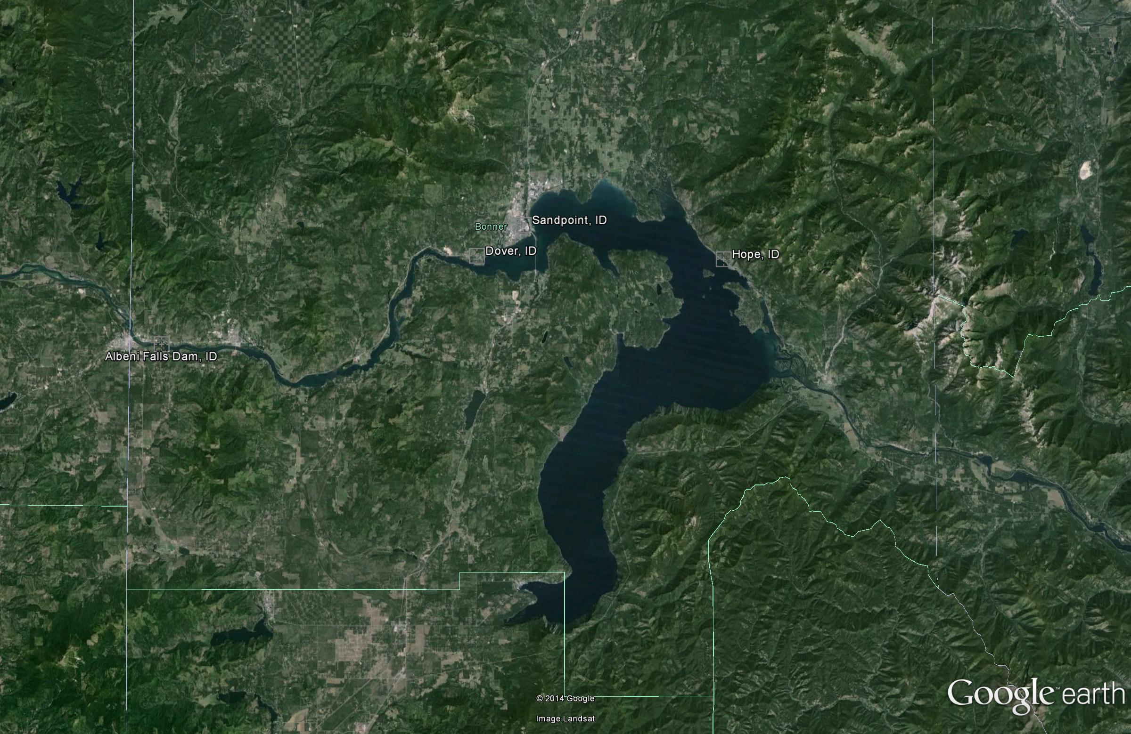
Lake Pend Oreille
Dover is location of channel restriction
Where lake elevation is measured
AFD is ~27 miles downstream of the lake

Slide 5
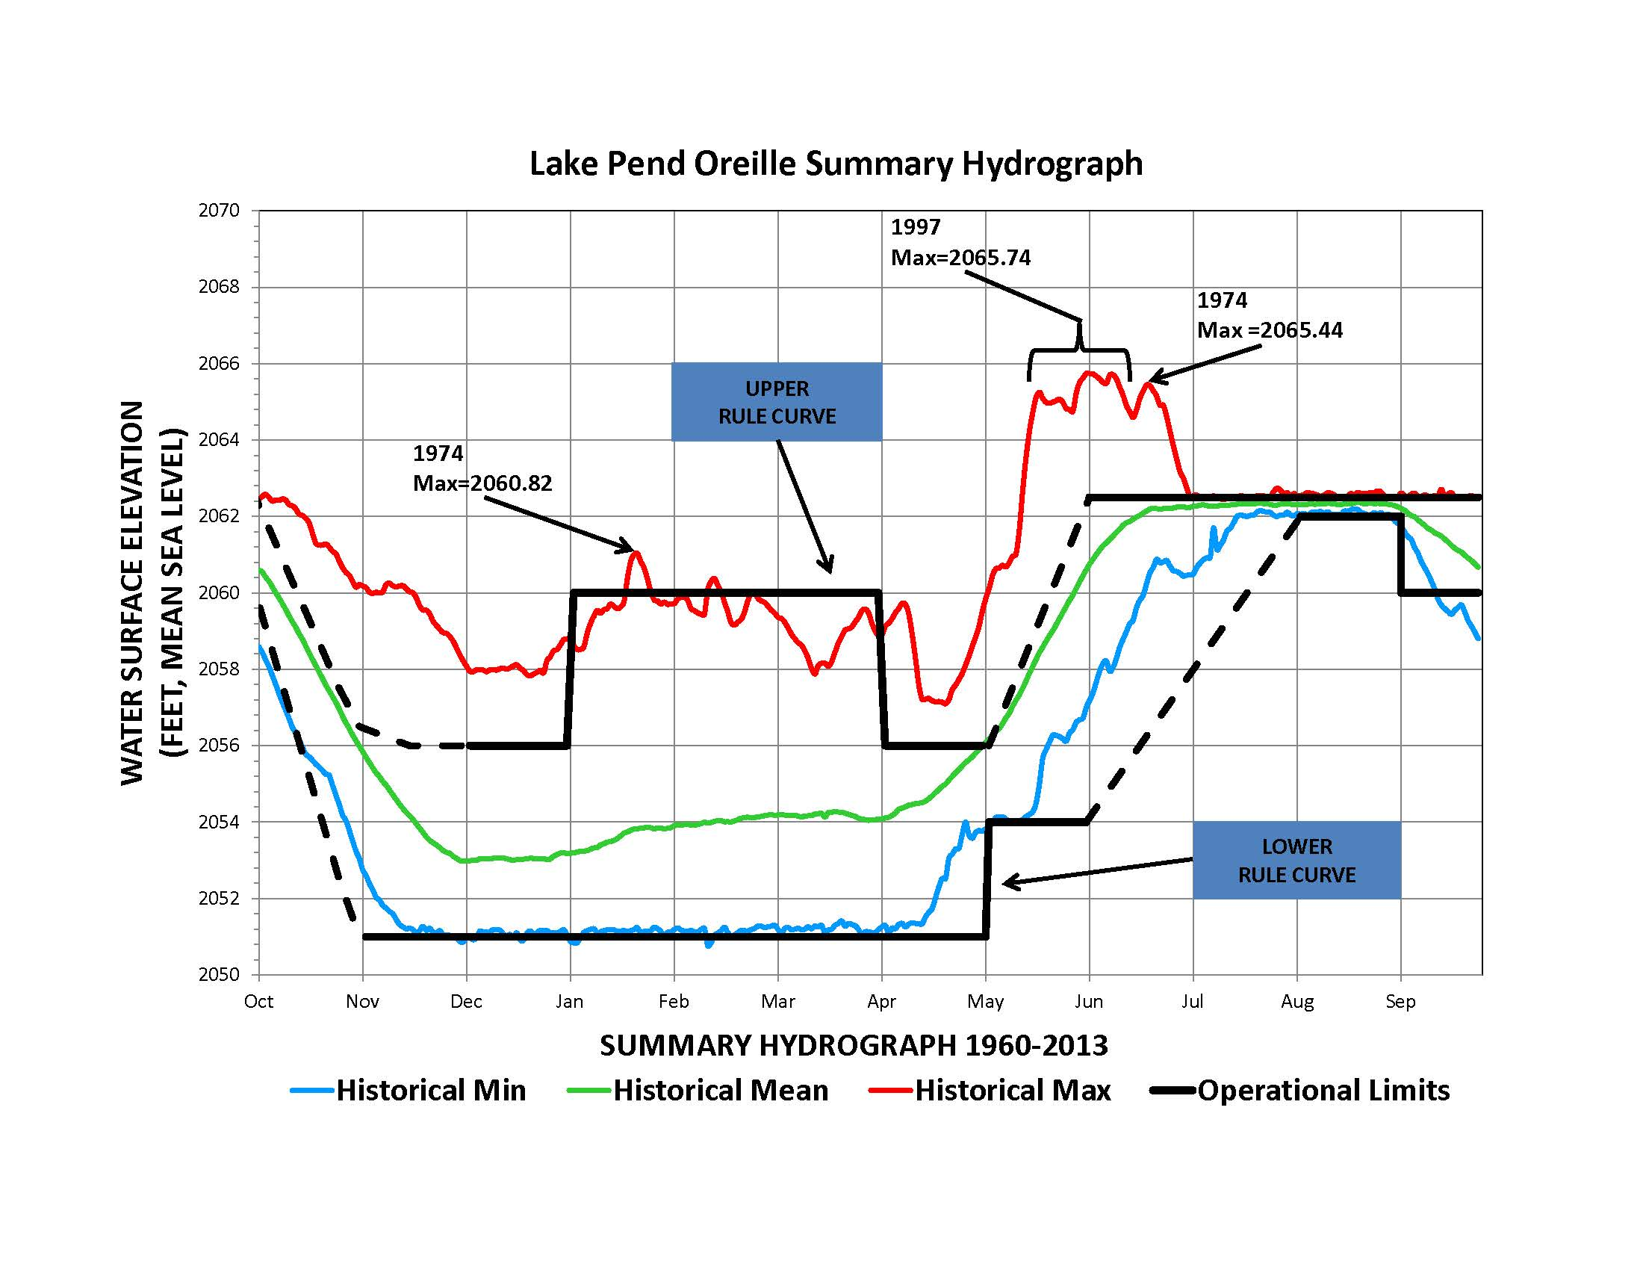

Slide 6
Annual Operation for Albeni Falls Dam and Lake Pend Oreille
Winter Jan through March
The lake level is held to no lower than the minimum control elevation to avoid dewatering kokanee redds.
The minimum control elevation can be set anywhere between 2,051 and 2,055 feet annually, with 2056 feet as a maximum elevation.
If the determined minimum control elevation is not met prior to the start of kokanee spawning, the lake is not lowered below the level at which kokanee are spawning to avoid dewatering kokanee redds.
During this period the Lake can be fluctuated to store and release water for power generation at downstream dams.
Flood risk management operations can store water up to 2060 feet during this period.
Spring flood season - April through June
The objective is to manage runoff for flood risk management.
The project will frequently go on “free flow” to pass as much water as possible through the project which helps minimize flood elevations on Lake Pend Oreille.

Slide 7
Annual Operations cont’d
Summer Holding Period July and August.
The lake is operated within a 0.5 range between 2,062 and 2,062.5 feet, stream flows permitting.
Drawdown and Stabilization - Sept through Dec
The lake is operated between elevations 2,060 to 2,062.5 feet in September and targets a draft to an elevation no lower than the minimum control elevation by mid-November.
The November objective is to stabilize the lake within a 0.5 foot range of the minimum control elevation for kokanee spawning, prepare for winter floods and generate coordinated power for the whole FCRPS. In December the lake level is managed to avoid dewatering kokanee redds.

Slide 8
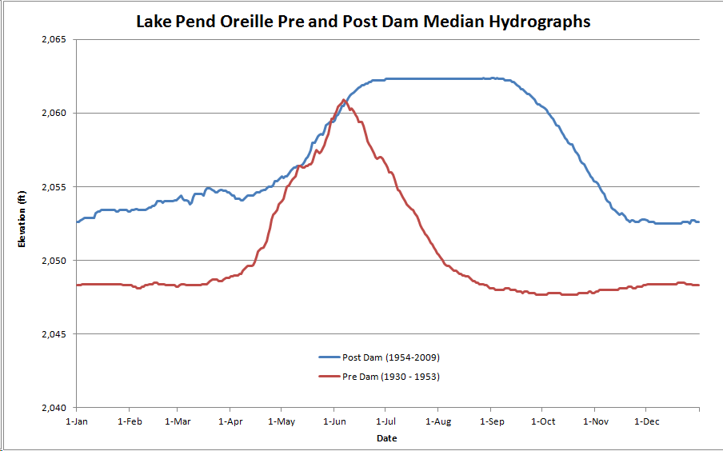

Slide 9
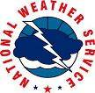
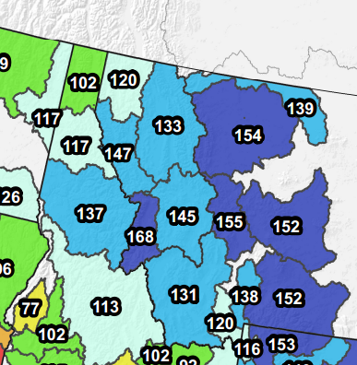
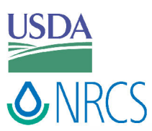
% of Average Snowpack April 2014
Measured at SNOTELS in Mountains
Notes:
Now snowpack is much better.
Much of the west saw gains.

Slide 10
2062 ft on June 24th

Slide 11
Freeflow
2013
Freeflow 2014

Slide 12
Operations Fall and Winter 2014
September
Lake Pend Oreille above 2,062 feet through Sept 15
Stay Above 2,061 feet through the third week
Target 2,060.5 feet Sept 30
Rowing Regatta Sept 26 to 28 hold flows target 12 to 14 kcfs steady – weather and streamflows permitting
October
Target 2,053 feet Oct 31st
Expect Flows Above 20 kcfs most of the month
Notes:
Red are subject to change depending on Kalispell Discussions and Projections

Slide 13
Operations Fall and Winter 2014 cont’d
November and Winter
Target being within the winter minimum control elevation of 2,051 feet by mid-November
No FWPO this year due to Clark Fork Delta work
Pool may fluctuate due to winter storms
Notes:
Red are subject to change depending on Kalispell Discussions and Projections

Slide 14
Coordinating Fall/Winter Operations post-2014
Currently working on a proposal with Federal partners, Kalispel Tribe, State of Idaho and Lakes Commission
Corps will lead the fall lake level meeting
Goal to finalize new lake level coordination process by Spring of 2015
No change to the operating limits of the Lake

Slide 15
Summary
Corps operates according to current water control plan
No plan to change summer operation which holds lake between 2062 and 2062.5 feet through Labor Day
Sept 2014
Lake Pend Oreille above 2062 feet through Sept 15
Stay Above 2061 feet through the third week
Target 2060.5 feet Sept 30
April 2015 Spring public meeting – flood potential for 2015

Slide 16
Questions
Seattle District – 206.764.3750
Scott Lawrence – 206.764.6896
www.nws.usace.army.mil
Flow updates and projections

